Slide 1
Development and validation of a consistency based multiple structure alignment algorithm
Jessica Ebert and Douglas Brutlag,
Bioinformatics, Vol.22, no.9, 2006, pp.1080–1087.
Presenter : Hsiao-Yen Chang
Date : May 16, 2007

Slide 2
Abstract
Summary: We introduce an algorithm that uses the information
gained from simultaneous consideration of an entire group of
related proteins to create multiple structure alignments (MSTAs).
Consistency-based alignment (CBA) first harnesses the information
contained within regions that are consistently aligned among a set
of pairwise superpositions in order to realign pairs of proteins
through both global and local refinement methods. It then
constructs a multiple alignment that is maximally consistent with the
improved pairwise alignments. We validate CBA’s alignments by
assessing their accuracy in regions where at least two of the
aligned structures contain the same conserved sequence motif.
Results: CBA correctly aligns well over 90% of motif residues in
superpositions of proteins belonging to the same family or
superfamily, and it outperforms a number of previously reported
MSTA algorithms.

Slide 3
Validation datasets
We have aligned structures from each family and superfamily in release 1.65 of the Structural Classification of Proteins (SCOP) that contains at least three sequences with the same PROSITE pattern or eMOTIF hit. These structures come from an ASTRAL subset of the SCOP database created in such a way that no two sequences
share >40% sequence identity.
Only structures from SCOP’s all alpha, all beta, alpha + beta and alpha/beta classes were considered.

Slide 4
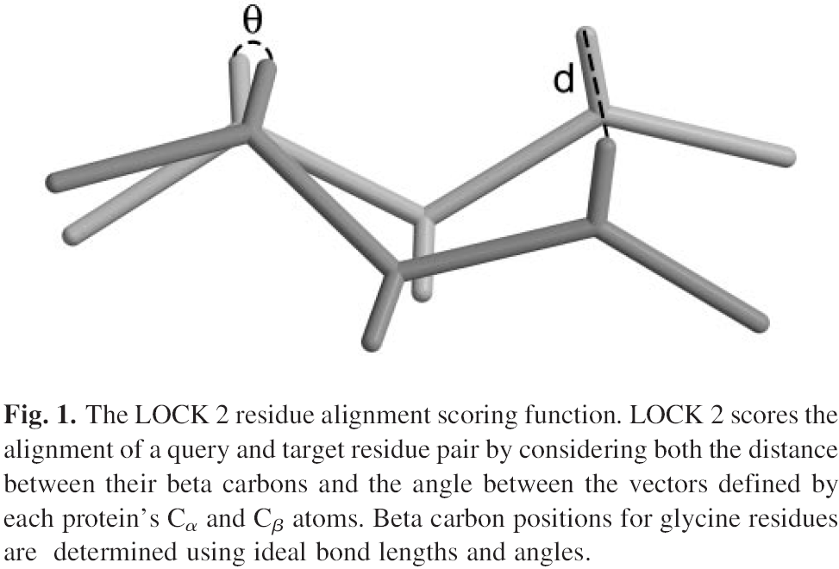
LOCK 2

Slide 5
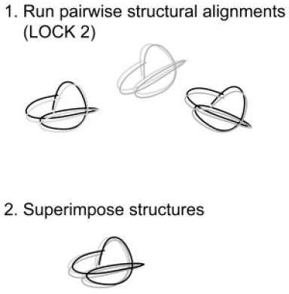
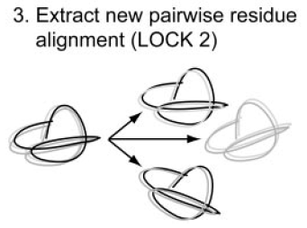
The CBA algorithm
Steps 1–3: obtaining an initial multiple superposition

Slide 6
Binary guide tree
In the trivial case of a node at the bottom of the tree with only two descendants, we transform one child structure onto the other using the transformation matrix from the pairwise alignment and label the parent node with the resulting superposition.
When a node has more than two descendants, we choose one descendant of the left child and one from the right such that the two selected structures have the highest alignment score among all such pairs, and then use their pairwise transformation to add all descendants from the left child to the right child’s MSTA.

Slide 7
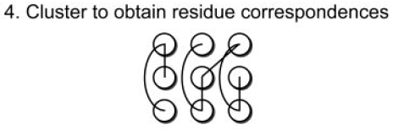
The CBA algorithm
Step 4: obtaining an initial residue registration across all structures
The fourth step of CBA applies a fast mplementation of the Markov cluster algorithm (MCL) (Van Dongen, 2000) to find the residue registration across all of the proteins that is maximally consistent with the pairwise alignments
obtained at the end of Step 3.

Slide 8
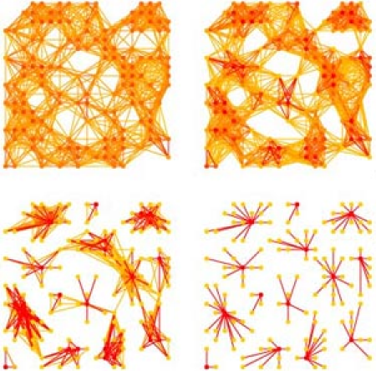
Markov Cluster algorithm
This Markov Cluster algorithm (MCL) is based on random walks on a graph, uses simple algebraic operations on its associated stochastic (Markov) matrix, and does not require a priori knowledge about an underlying cluster structure.

Slide 9
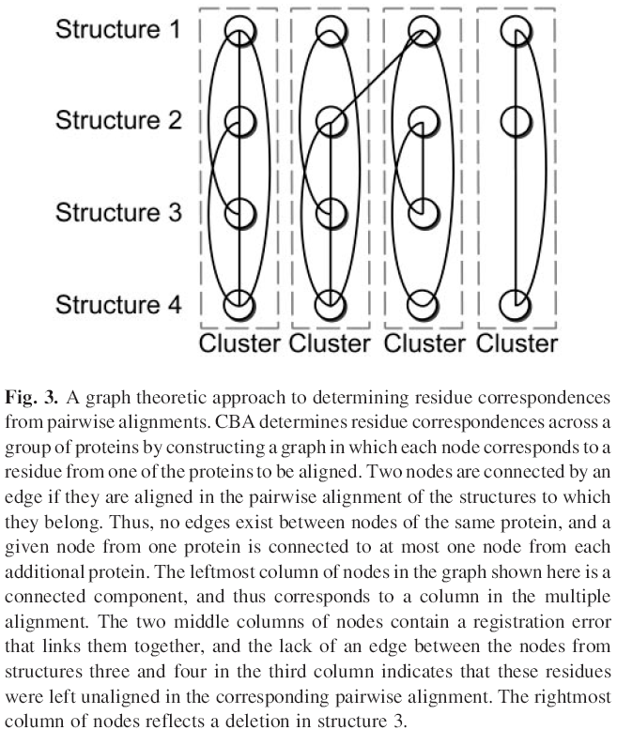
Markov Cluster algorithm

Slide 10
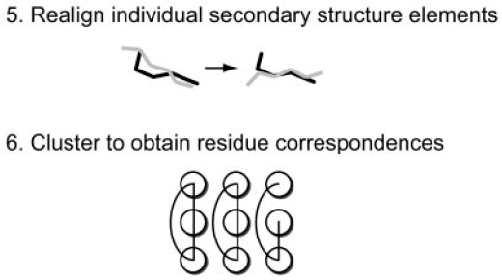
The CBA algorithm
Steps 5 and 6: realignment of secondary structure elements
Realigning each pair of superimposed secondary structure elements in isolation circumvents this limitation of rigid body superposition algorithms, which cannot always optimally superimpose all structurally
similar regions of two proteins simultaneously.

Slide 11
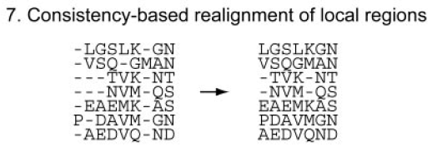
The CBA algorithm
Step 7: realignment of local regions
Regions to be realigned are derived both from secondary structure elements with gaps and from areas containing MSTA columns established by the MCL algorithm that violate sequence order constraints or that contain more than one residue from the same
protein.

Slide 12
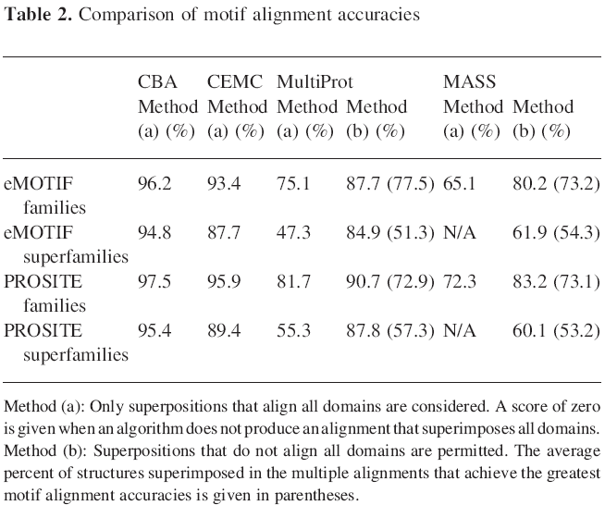
Result

